Slide 1
Development of Computer Games
Course: Academic English
Students：
8002118240
Yang Meng Heng
8002118225
Liao Yan Hao
8002118221
Peng Ling Han
Class:
Software Engineering 1809

Slide 2
Game development overview
Role playing game
Catalog
CONTENTS
Development of
Game programming
Future computer games

Slide 3
Game development overview

Slide 4
"Anpolyphenol" is a gift given by God to human beings. All games are designed to bring happiness to human beings. Video games are a new form of bringing happiness to human beings with the emergence of computers.
Since the birth of the world's first video game in 1947, the development of game software and hardware (all kinds of game consoles and PCS) complement each other.

Slide 5
Development of the times
summary
1947
The first video game in the world
CRT entertainment device
twenty-first century
Microsoft, Sony and Nintendo have divided the entire video game market
1971
The first commercial video game in the world
Cyberspace
1994-1998
The age of 32 bit machine hegemony
Sony’s development
1983-1986
1987-1990
The rise of Nintendo
The age of 16 bit machine hegemony

Slide 6
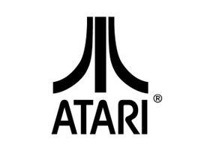
The ancestor of video games
Atari Company

Slide 7
Console
Handheld
Console is the most common game platform.
Such as Famicom（即红白机）、SuperFamicom、SegaMegaDrive、PC-Engine、Nintendo64、SEGASaturn、Sony’s PlayStation series
Since the late 1980s, mobile electronic components used by individuals have become a trend, such as mobile phones, and a new consumption mode has been formed. Of course, game manufacturers have also developed portable game consoles.
Arcade
Video game machine
Personal Computer
Arcade is a popular commercial game machine on the street, which is different from personal computer and home game machine by this name. Famous machine version: capcomcps-1 and cps-2, snkno GEO, Sega's model series and Naomi series.
For personal computer game platform, please refer to computer games.

Slide 8
Video game sales ranking
Honor Award
Mario
first
Pokemon
second
Tetris
third

Slide 9
Adventure Game
Action Game
冒险游戏
动作游戏
Role Playing Game
First Person Shooting Game
角色扮演游戏
Video game classification
第一人称射击游戏

Slide 10
Role playing game

Slide 11
What’s the RPG games?
Game play
Players play a role in a realistic or virtual world.
The player is responsible for playing the role and
developing the role through some actions
under a structured rule.
Game Core
Create yourself virtual role, and act him.
Game environment
A realistic or virtual electronic world
Game fundamentals
A formal system of rules

Slide 12

The world's first open World RPG
Ulitima

Slide 13
Game play classification
Action
动作
Strategy
策略
MMO
大型多人在线
Simulation
模拟
Other
其他
RPG

Slide 14
Game carrier
Table
-top
Live-Action
Soft-
ware
Table role-playing games, referred to as TRPG. Sometimes referred to as "pen and paper" (PNP) games, these games usually start with a small social gathering.
Live action role-playing game is usually referred to as LARP. Participants use their limbs to imitate their roles, not their mouths, but to restore the real environment they imagined.
The electronic game of software platform usually uses software app to play games. Game rules and other game playing methods are realized in app through programming.

Slide 15
What’s TRPG?

Slide 16

What’s this?
The photo is about a game named Call of Cthulhu. It’s one of TRPG games. Trooper is a popular name for TRPG (table role playing game), and it is a popular form of table game.
How to play?
The game often consists of three or five people, one of whom acts as the host of the game, and several others act as the player. When running a group game, the commonly used game props are maps, dice and rule books.
Where to play?
According to the different game places, the running team can be divided into "dough" (face-to-face games) and "network group" (playing games through instant messaging tools on the Internet).

Slide 17
What’s Live-Action?

Slide 18

What’s this?
The photo is about a Live-Action game. It’s one of TRPG games. Live action role playing game is usually referred to as LARP.
How to play?
This kind of role-playing game feels more like an improvisational theatre, in which participants imitate their roles with their bodies rather than with their mouths, and are used to restore what they imagine to be the real environment.

Slide 19
What’s Software?

Slide 20
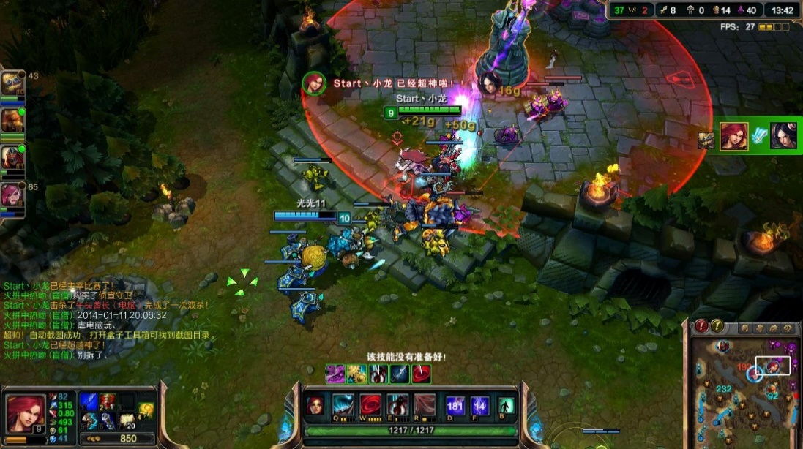
What’s this?
The photo is about a game named League of Legend on software platform. Role playing games on electronic platforms usually come directly from the design of role-playing games on the table. The mature rules of role-playing games on the table will be transformed into the electronic platform by programming means. Some scholars divide electronic media role-playing games into two types: single player games with RPG style mechanism and multiplayer games with social interaction.

Slide 21
Development of
Game programming

Slide 22
Development
In the early 1970s, when the video game industry was just sprouting, it used assembly language for programming. With the progress of computer science and technology, more and more programming languages than assembly language appear, and playing games has become a normal life, so game development is becoming more and more popular.
Assembly
C language
C++
Java

Slide 23
With the passage of time, assembly language gradually withdrew from the stage of game development,
but C + + , C# language and Java language became more and more popular, which became the best choice for modern game development.

Slide 24
What is the game developed
by C + + language?

Slide 25
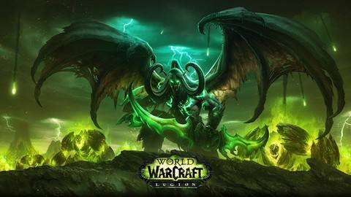
What’s this?
The photo is about a game called World of Warcraft. It is a game based on the game engine developed by C + +. It is the first online game produced by the famous game company Blizzard Entertainment. It belongs to large-scale multiplayer online role-playing game. The game takes the plot of the real-time strategic game Warcraft produced by the company as the historical background. Relying on the historical events and heroes of Warcraft, the world of Warcraft has a complete historical background timeline.

Slide 26
What is the game developed
by C# language?

Slide 27

What’s this?
This picture is about a game called Honor of Kings. It is a game based on a C# developed game engine. This is a MOBA mobile game developed and run by Tencent Game Tianmei Studio group operating on Android, IOS and NS platforms. The gameplay in Honor of Kings is based on competitive battles and belongs to role-playing games. The game takes the plot adapted by the company as its historical background. Rely on the historical events of China and the heroic role of the two sides to engage in fair confrontation.

Slide 28
What is the game developed
by Java language?

Slide 29
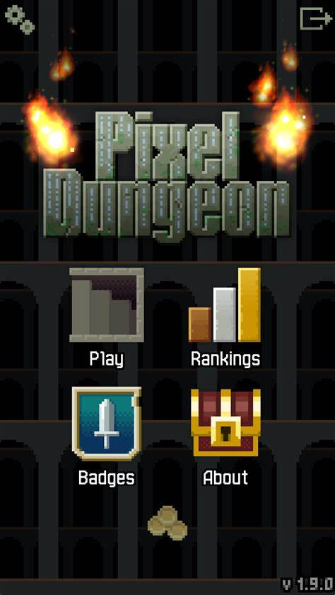
What’s this?
The photo is about a game called Pixel Dungeon. This is a small game based on Java development, pixel dungeon is a role-playing game, the game is very simple, traditional, control the protagonist in the dungeon to explore, collect useful items, defeat all kinds of enemies, the game has a wide map waiting for you to explore.

Slide 30
Future computer games

Slide 31
VR & AR
Advanced Technology
虚拟现实
VR
AR
增强现实
VR is the abbreviation of virtual reality, namely virtual reality.
AR is augmented reality technology, that is, augmented reality.

Slide 32


VR & AR
Advanced Technology
VR
AR

Slide 33
Video games of the future
PlayStation 5

Slide 34
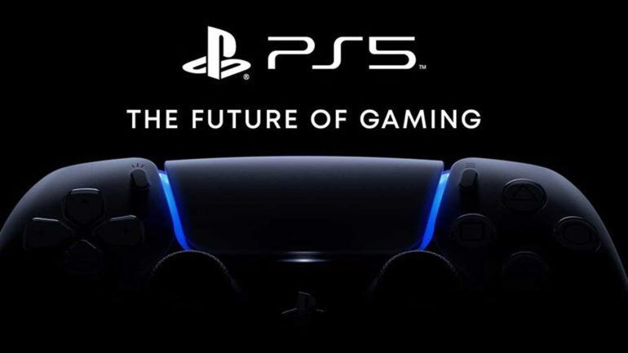
What’s this?
The photo is about a video game player named PlayStation 5. It's Sony's next generation game console.
What games can we play on the PS5 platform?

Slide 35


GTRace7
GTA5
Stray
Video Game
RE8
Returnal
GodFall

Slide 36
The future of the game world is the world of audio and video quality, and the more important is the real experience of the game.
Therefore, no one can say exactly how the future video game world is, but what can not be ignored is that the current video game industry is booming!

Slide 37
感谢您的聆听！
Thank you for listening!

